Slide 1
PROJECT TITLE : Finance Receipting using Robotic Process Automation
PIP2001 Capstone Project
Review-1
Batch Number: CSD-G36
Under the Supervision of,
Dr. Chandrasekar Vadivelraju Professor, School of Computer Science and Engineering
Presidency University
STUDENT ROLL NO | STUDENT NAME
20211CSD0132 | KEREN ELISHEBA S
20211CSD0179 | VIKHYATH M B
20211CSD0168 | CHIRAG K SRINIVAS
Name of the Program: B.Tech Computer Science Engineering in Data Science
Name of the HoD: Prof. Saira Banu
Name of the Program Project Coordinator: Dr. Manjula H M
Name of the School Project Coordinators: Dr. Sampath A K / Dr. Abdul Khadar A / Mr. Md Ziaur Rahman

Slide 2
Content
Abstract
Literature Survey
Objectives
Existing Methods-Drawbacks
Proposed Method
Architecture Diagram
Modules
Hardware and Software Details

Slide 3
Content
Algorithm
Results
Time Line by Gantt Chart
Conclusion
References
Github Link
Project work mapping with SDG

Slide 4
Abstract
Robotic Process Automation (RPA) is transforming finance receipting by streamlining and automating repetitive, rule-based tasks, leading to enhanced operational efficiency and reduced manual effort. In finance receipting, RPA automates the process of capturing, validating, and reconciling payment receipts, ensuring greater accuracy and speed in data entry, invoice processing, and payment tracking. This technology eliminates human errors, accelerates transaction cycles, and improves cash flow management. By integrating RPA into receipting, organizations can achieve higher productivity, reduce operational costs, and ensure compliance with financial regulations. The adoption of RPA enhances decision-making through real-time data availability, allowing finance teams to focus on more strategic activities. This paper explores the benefits, challenges, and best practices of implementing RPA in finance receipting processes, highlighting its potential to revolutionize financial operations.

Slide 5
Literature Survey
J. G. Enríquez, A. Jiménez-Ramírez, F. J. Domínguez-Mayo and J. A. García-García, "Robotic Process Automation: A Scientific and Industrial Systematic Mapping Study“, in IEEE Access, vol. 8, pp. 39113-39129, 2020, doi: 10.1109/ACCESS.2020.2974934.
Kosadi, Ferry & Ginting, Wajib & Merliana, Vina. (2021). Digital Receipts of Online Transactions in the Reconciliation Process and the Preparation of Financial Reports. Journal of Indonesian Economy and Business. 36. 31. 10.22146/jieb.59884.
Costa, Diogo & S. Mamede, Henrique & Mira da Silva, Miguel. (2022). Robotic Process Automation (RPA) Adoption: A Systematic Literature Review. Engineering Management in Production and Services. 14. 1-12. 10.2478/emj-2022-0012.
Madakam, S., Holmukhe, R. M., & Jaiswal, D. K.. (2019). The Future Digital Work Force: Robotic Process Automation (RPA). JISTEM - Journal of Information Systems and Technology Management, 16, e201916001. https://doi.org/10.4301/S1807-1775201916001
Balamurugan, A & Vamsi, M & Bhattacharya, Rajib & Mohammed, Shariq & Kaushik, Priyanka & Haralayya, Dr. (2023). ROBOTIC PROCESS AUTOMATION (RPA) IN ACCOUNTING AND AUDITING OF BUSINESS AND FINANCIAL INFORMATION. Manager. 58. 127-142.

Slide 6
Literature Survey
Ayinla, Benjamin & Atadoga, Akoh & Ike, Chinedu & Ndubuisi, Ndubuisi & Asuzu, Onyeka Franca & Adeleye, Rhoda. (2024). THE ROLE OF ROBOTIC PROCESS AUTOMATION (RPA) IN MODERN ACCOUNTING: A REVIEW - INVESTIGATING HOW AUTOMATION TOOLS ARE TRANSFORMING TRADITIONAL ACCOUNTING PRACTICES. Engineering Science & Technology Journal. 5. 427-447. 10.51594/estj.v5i2.804.

Slide 7
Objectives
Design a solution to integrate paper-based receipts into the automated workflow, possibly using Optical Character Recognition (OCR) technology. Maintain high accuracy in data processing and receipt generation, ensuring compliance with financial regulations and company policies.
Streamline the processing of 25,000 structured receipts per month using UiPath, reducing manual effort and errors.
Develop a system to segregate transaction types (Card and Cheque) based on pre-defined business rules.
Design a modular system that allows for the integration of AI tools (e.g., OCR, anomaly detection, and NLP chatbots) to handle semi-structured data, fraud detection, and user interactions in future enhancements.

Slide 8
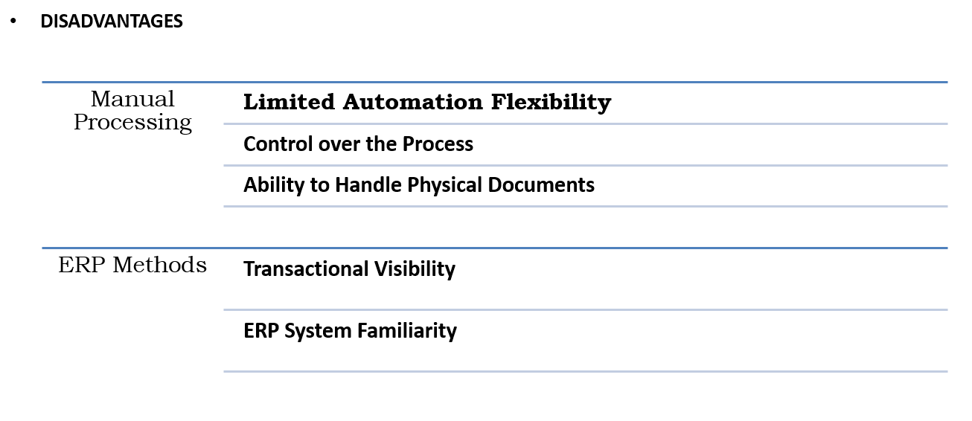
Existing Methods-Drawbacks

Slide 9
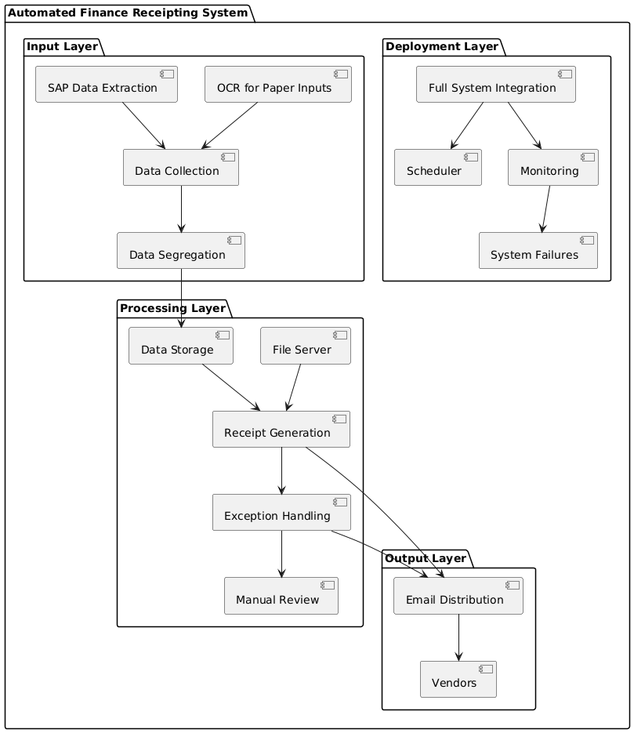
Proposed Method

Slide 10
Modules
Module 1: Data Gathering Using OCR/Paper Based Receipts
Module 2: Data Segregation and Rules Engine
Module 3: Document Generation Module
Module 4: Email Automation
Module 5: Exception Handling and Deployment

Slide 11
Hardware and Software Details
Software Details:
Robotic Process Automation (RPA) Platform
OCR Technology
Tesseract
Gradio

Slide 12
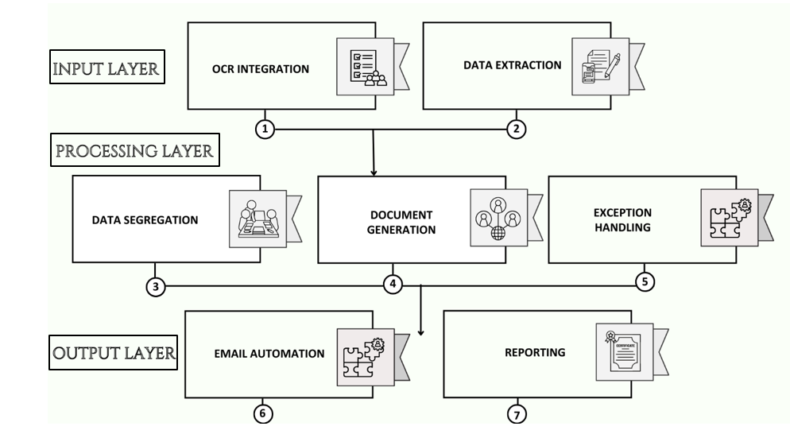
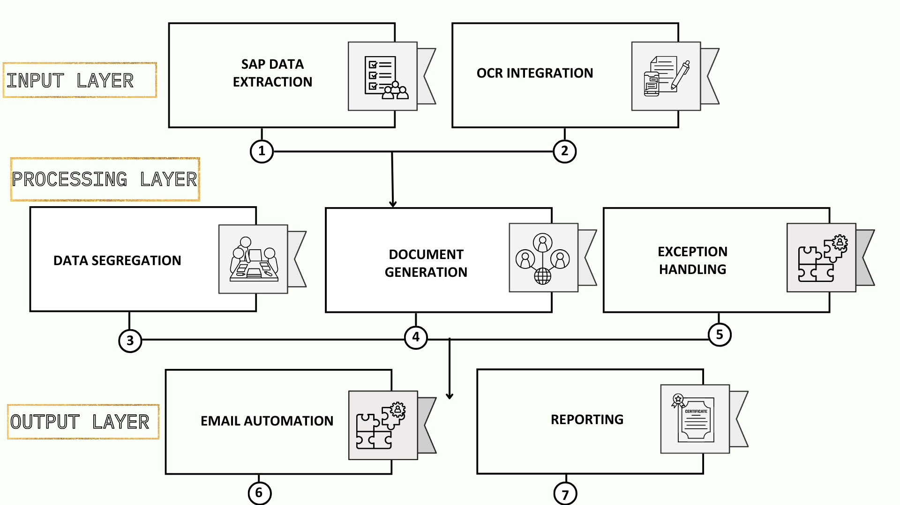
Architecture Diagram

Slide 13
System Design & Implementation
- Layered Architecture:
- Input Layer: OCR extracts data from scanned receipts; structured fields like receipt numbers and vendors are retrieved.
- Processing Layer: Data segregated by transaction type; templates auto-generated; AI flags anomalies for review.
- Output Layer: Automated emails send receipts; reporting provides performance insights.
- Web App Deployment:
- Frontend: User-friendly interface hosted on a web server.
- Backend: Gradio-powered APIs integrating RPA tools and AI models.
- Data Layer: Secure storage for files and transactions.
- AI Augmentation: NLP chatbot supports anomaly detection and user queries.
- Deployment Workflow: Development, hosting, and monitoring ensure scalability and reliability.

Slide 14
Algorithm
def process_receipts(file):
# File Upload and Validation
validate_file(file)
if is_scanned_document(file):
data = extract_with_ocr(file)
else:
data = parse_csv_or_excel(file)
# Data Validation
clean_data = validate_and_clean(data)
# Data Segregation
card_data, cheque_data = segregate_by_payment_type(clean_data)
# Document Generation
for receipt in card_data + cheque_data:
generate_receipt_template(receipt)
#Anomaly Detection
anomalies = detect_anomalies(clean_data)
flag_suspicious(anomalies)
#Email Automation
for vendor in clean_data['vendor_list']:
send_email(vendor, receipt)
#Generate and Save Reports
report = generate_report(clean_data, anomalies)
save_report(report)
return "Processing Complete"

Slide 15
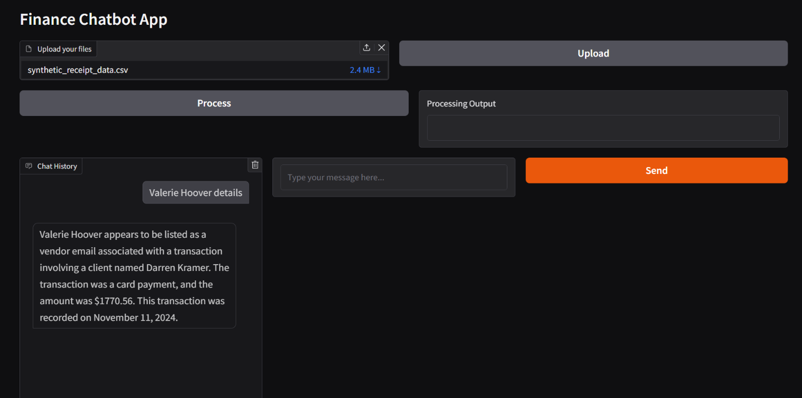
Results
Successfully automated the processing of 25,000 receipts per month, reducing manual effort by approximately 90%.

Slide 16
Results
ACCURACY TABLE:
Component | Accuracy (%)
Robotic Process Automation (RPA) | 99%
Optical Character Recognition (OCR) | 85%
Natural Language Processing (NLP) | 92%
Anomaly Detection | 95%

Slide 17
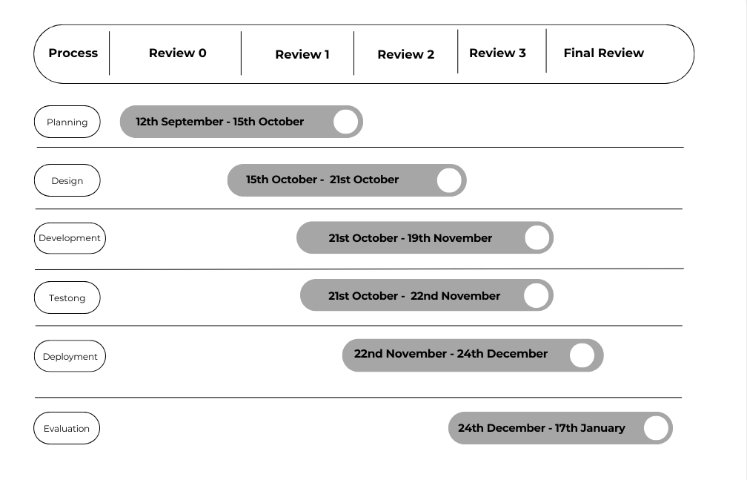
Timeline of the Project (Gantt Chart)

Slide 18
Conclusion
In this project, we have designed and will implement an automated Finance Receipting solution using Robotic Process Automation (RPA) to streamline and optimize back office operations. The automation solution is capable of handling a high volume of 25,000 receipts per month, with minimal manual intervention, while addressing the challenges posed by structured and paper- based data inputs. By leveraging RPA to automate tasks such as data extraction, segregation, receipt generation, and email distribution, we have successfully enhanced operational efficiency, accuracy, and scalability.
In conclusion, the automated finance receipting system presents a scalable, robust, and efficient approach to managing high-volume financial transactions, which can be easily adapted to other industries with similar repetitive tasks.
The solution not only addresses current business needs but also sets the stage for future advancements
in automation and process optimization, offering considerable long-term benefits for organizations.

Slide 19
References (IEEE Paper format)
K. T. Wadsworth, M. T. Guido, J. F. Griffin and A. Mandil, "An innovation in paper receipts: the electronic receipt management system," 2010 IEEE Systems and Information Engineering Design Symposium, Charlottesville, VA, USA, 2010, pp. 88-93, doi: 10.1109/SIEDS.2010.5469674.
Balamurugan, A & Vamsi, M & Bhattacharya, Rajib & Mohammed, Shariq & Kaushik, Priyanka & Haralayya, Dr. (2023). ROBOTIC PROCESS AUTOMATION (RPA) IN ACCOUNTING AND AUDITING OF BUSINESS AND FINANCIAL INFORMATION. Manager. 58. 127-142.
Costa, Diogo & S. Mamede, Henrique & Mira da Silva, Miguel. (2022). Robotic Process Automation (RPA) Adoption: A Systematic Literature Review. Engineering Management in Production and Services. 14. 1-12. 10.2478/emj-2022-0012.

Slide 20
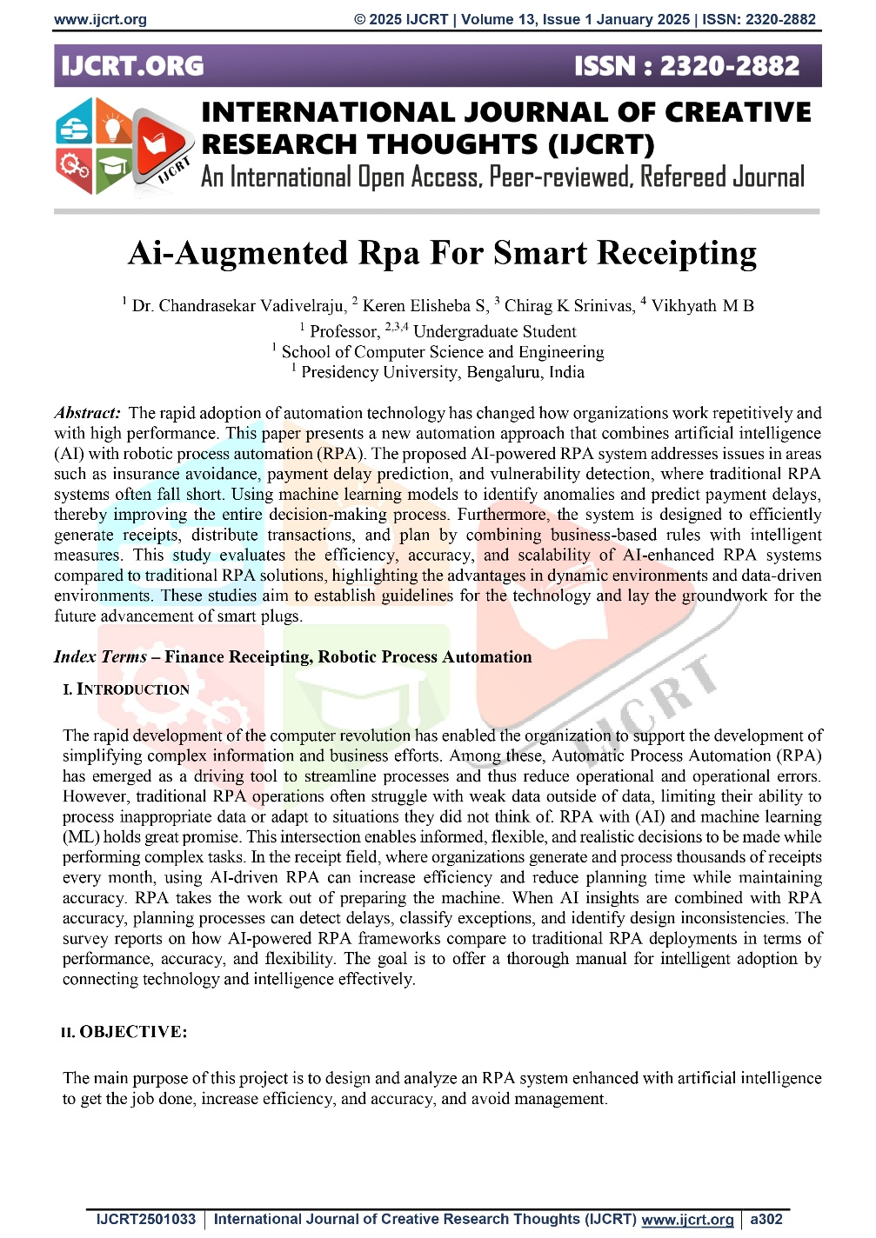
Publication
Published URL: http://www.ijcrt.org/viewfull.php?&p_id=IJCRT2501033

Slide 21
GITHUB LINK
https://github.com/keren05/CAPSTONE-PROJECT-G36

Slide 22

Project work mapping with SDG

Slide 23
Project work mapping with SDG
Sustainable development goals of Finance Receipting Using RPA:
SDG 8 (Decent Work and Economic Growth): Enhances productivity by automating receipt processing, reducing manual effort, and promoting financial transparency.
SDG 9 (Industry, Innovation, and Infrastructure):
Encourages the adoption of advanced technologies like OCR, NLP, and anomaly detection, fostering innovation in financial workflows.
SDG 12 (Responsible Consumption and Production): Supports paperless operations by digitizing receipt processing, reducing environmental impact, and promoting responsible financial management.
SDG 16 (Peace, Justice, and Strong Institutions): Strengthens financial integrity by detecting fraud and ensuring transparency in transactions.
SDG 17 (Partnerships for the Goals): Combines tools like UiPath, Gradio, and anomaly detection models, promoting collaboration and scalability across industries.

Slide 24


